Slide 1
Global Superstore Sales Performance Dashboard
Interactive Dashboard Summary

Slide 2
Dashboard Overview
Visualize key sales and profit metrics
Track performance trends over time
Identify top customers and product categories
Compare Year-over-Year growth
Understand market and regional performance

Slide 3
Executive KPIs
KPIs Displayed:
Total Sales: $13M
Sales YoY: $8M
Profit Margin: 12%
Total Profit: $1.47M
Total Orders: 25K
Sales Growth YoY %: 52%
Strong YoY growth in sales
Profit margin needs improvement
High order volume indicates strong customer engagement

Slide 4
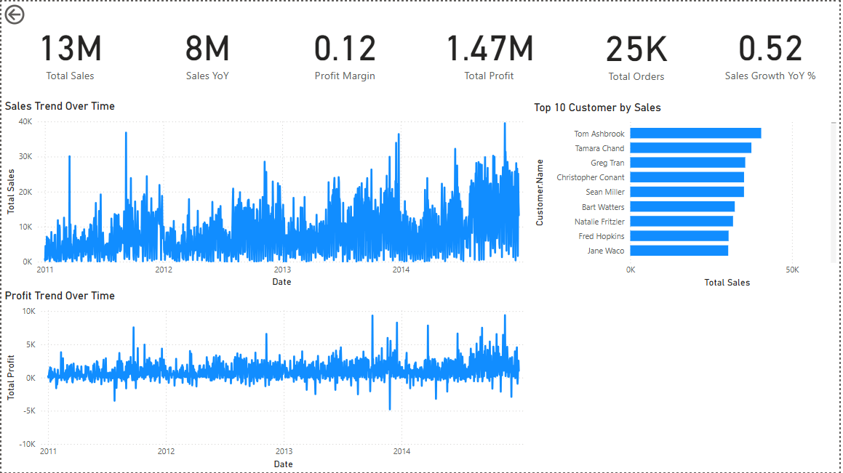

Slide 5
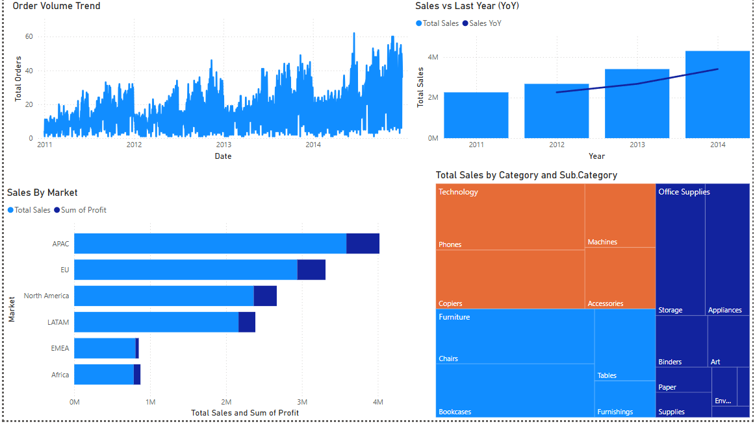

Slide 6
Insights
Sales & Profit Trends
Sales steadily increased from 2011 to 2014
Profits show more volatility; possible margin pressure or returns
Top Customer Insights
Tom Ashbrook and Tamara Chand are top contributors
Focus on high-value customers for loyalty initiatives
Order Volume & YoY Comparison
Orders increased consistently
Clear YoY growth—especially strong in 2014
Regional Performance
APAC leads in both sales and profit
North America and EU also perform well
Consider strategic focus on underperforming regions (Africa, EMEA)
Product Category Insights
Technology and Office Supplies dominate sales
High sales in Phones, Machines, Copiers
Opportunity: Grow smaller categories with marketing pushes

Slide 7
Summary & Recommendations
Sales and orders have grown YoY, especially in APAC
Focus on improving profit margin while maintaining growth
Target top customers with tailored promotions
Monitor underperforming markets and product categories
Use filters and time slicers for deeper exploration in Power BI

